Slide 1
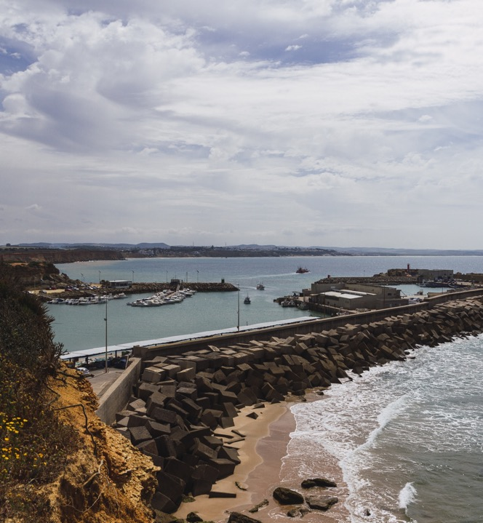
Response Strategies - Shoreline
Notes:
Welcome / title slide. Introduce Module 8, confirm it builds on earlier modules covering spill response fundamentals, and set expectations: a mix of theory, group exercises and practical planning tools for shoreline response.

Slide 2
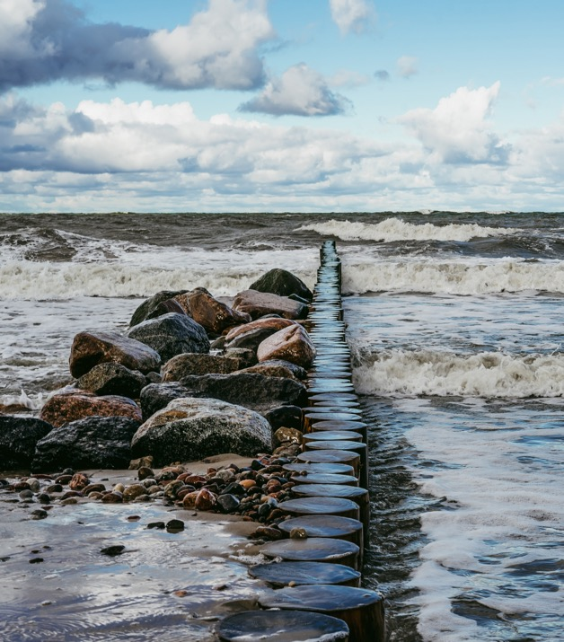

Response Strategies - Shoreline
Objectives
1
To understand the phases in shoreline clean up
2
List the different shoreline types
3
Understand what is included within the shoreline site setup
Notes:
Understand the phases in shoreline clean-up
Understand the various shoreline treatment options
Understand the basis of shoreline treatment recommendations
Understand what is included within the shoreline site setup
Understand the importance of logistical supply chain
Understand the significance of an equipment staging area
Understand the importance and requirements of a de-contamination area

Slide 3
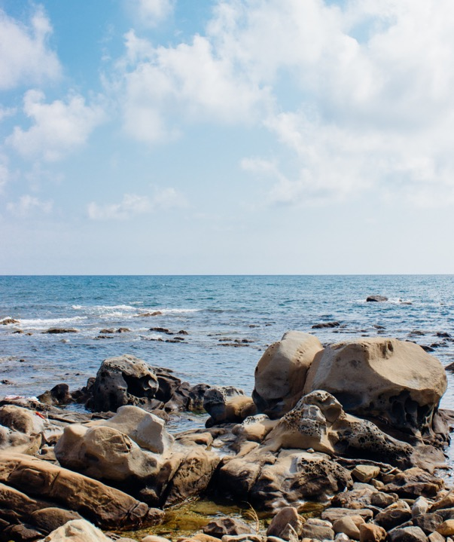
Shoreline Types
10 minutes – write/draw on whiteboard
1. List as many as possible / 2. Natural or manmade / 3. Permeable or Impermeable / 4. Label in order of sensitivity
Notes:
Facilitator exercise (10 minutes): split delegates into groups and get them to brainstorm as many shoreline types as possible on the whiteboard, then classify each as natural/man-made, permeable/impermeable, and rank in order of sensitivity.
Use this to gauge existing knowledge before introducing the formal ranking scale on the next slide - capture their answers and revisit them once the scale has been shown.

Slide 4
Shoreline Types
Shoreline Habitat Rankings
1
Exposed walls and other sold structures
7
Exposed Total Flats
Made of concrete concrete, wood or metal
8A
Exposed pop rap structures
2A
Scarps and steep slopes in clay
Wave cut clay platforms
8B
Sheltered solid man-Made structures
2B
8C
Sheltered Scarps
3A
Fine – granted sand beaches
3B
Scarps and steep slopes in sand
9A
Sheltered Total Flats
9B
Riverine banks with grasses or trees
4
Coarse- grained sand beaches
10A
Salt and brackish water marshes
5
Mixed sand and gravel beaches
10B
Frwshwate Marses (Herbaceous Vegetation)
6A
Gravel Beaches
10C
Freshwater Swamps (Woody Vegetation)
6B
Exposed pop rap structures
Notes:
Introduce the Shoreline Habitat/ESI-style ranking, from 1 (exposed walls and solid structures - least sensitive/most robust) to 10 (marshes and swamps - most sensitive). Compare against what delegates listed in the previous exercise.
General rule: exposure to wave energy decreases and biological sensitivity increases as the ranking number rises.
Note for trainer: this slide has a few typos worth correcting before delivery - 'sold structures' should read 'solid structures', 'concrete concrete' is duplicated, 'pop rap structures' should read 'riprap structures' (appears twice), 'Total Flats' should read 'Tidal Flats', 'Fine - granted sand' should read 'grained', and 'Frwshwate Marses' should read 'Freshwater Marshes'.

Slide 5
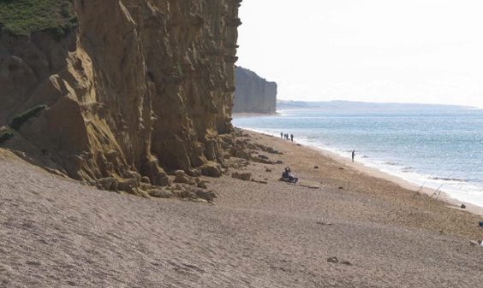
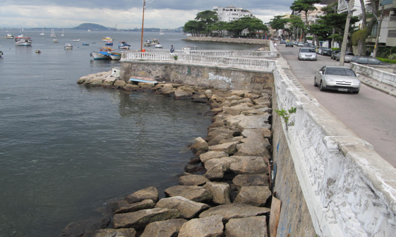
Coastal Character
Shoreline Type
Notes:
Explain the relationship between Shoreline Type (the immediate intertidal substrate, e.g. the sand and cliff beach shown) and Coastal Character (the wider backshore/inland setting, e.g. the sea wall and road shown). Both must be assessed together during a survey to properly characterise a site and plan a response.

Slide 6
Shoreline Types
Oil Spills can affect
Operations activities
Intertidal zone
Supratidal zone
Therefore, base characterization on these zones (Shoreline type)
Take place in backshore zone
Therefore, must also characterize area inland of the shoreline (Coastal Character)
Notes:
Explain that oil spill impacts and response operations occur across both the intertidal zone and the supratidal/backshore zone.
Operations activities generally take place in the backshore zone, so the area inland of the shoreline (Coastal Character) must also be characterised, not just the shoreline itself (Shoreline Type).

Slide 7

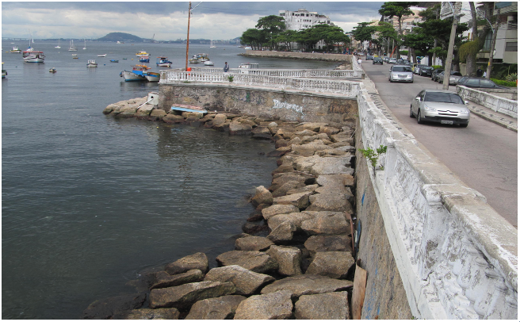
Beaches are classified based on grain size
How would you describe the grain size on these two shorelines?
Notes:
Show the two shoreline photos and ask delegates to describe the grain size differences before revealing the formal grain-size classification on the next slide. Prompt discussion: how might grain size affect how oil penetrates the substrate and how easy clean-up will be?

Slide 8
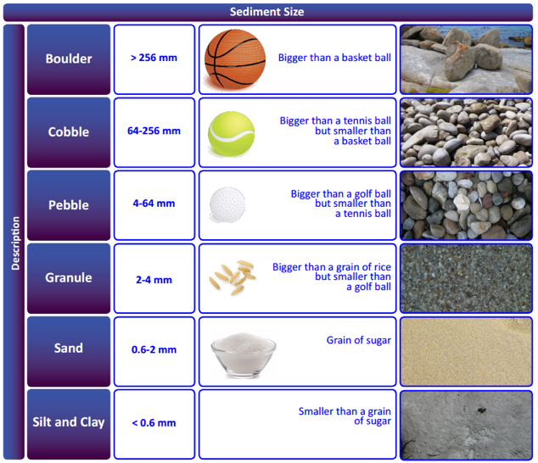
Oil and Sediment Size
Important in understanding how the oil behaves on the shoreline.
Relates to which response options are the most appropriate and will be the most effective.
10/1/26
Notes:
Explain why grain size matters: it governs how oil penetrates and adheres to the substrate, which in turn drives the choice of response technique.
Coarser sediment (gravel/cobble) allows oil to penetrate deep into the substrate, while fine sand tends to keep oil closer to the surface. Links forward to the cobble/pebble examples on the next slide.

Slide 9
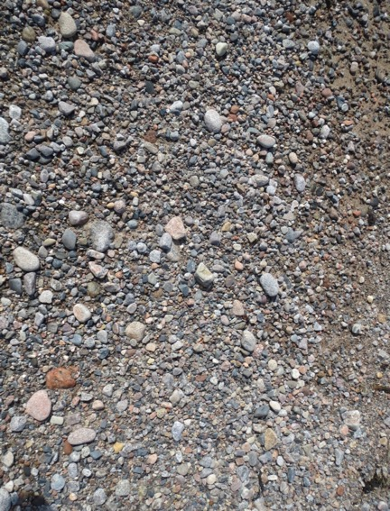
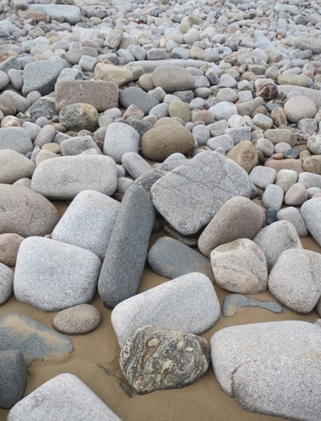


Cobbles
Pebbles
Notes:
Photos from Nigg Bay Aberdeen
May need to look at photos with a scale!

Slide 10
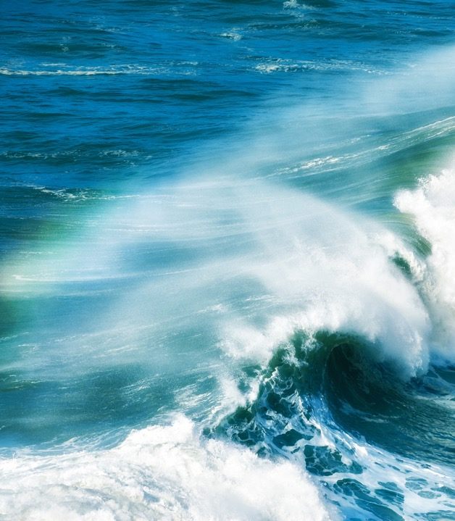
Wind and Waves
Notes:
Section divider. Transitions from shoreline classification into the physical processes - wind, waves and tides - that shape shorelines and determine how and where oil strands.

Slide 11
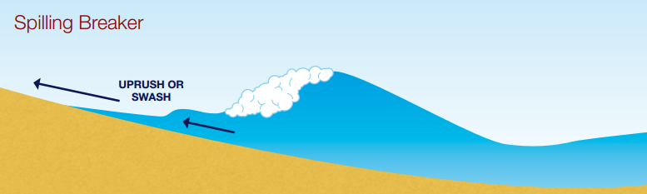

Types of Waves
Horizontal Energy
Vertical Energy
Vertical Energy
Notes:
Spilling Breaker:
Horizontal energy: Waves come up and down the beach. Moves sediment up and down the beach but not all the way back down. Builds sediment up the beach.
Low energy
Plunging Breaker
Vertical Energy: Energy moves vertically, not horizontally. Turbulence lifts the sediment up and pulls it down the beach. Generally they erode the beach.
Commonly associated with storms
High Energy

Slide 12
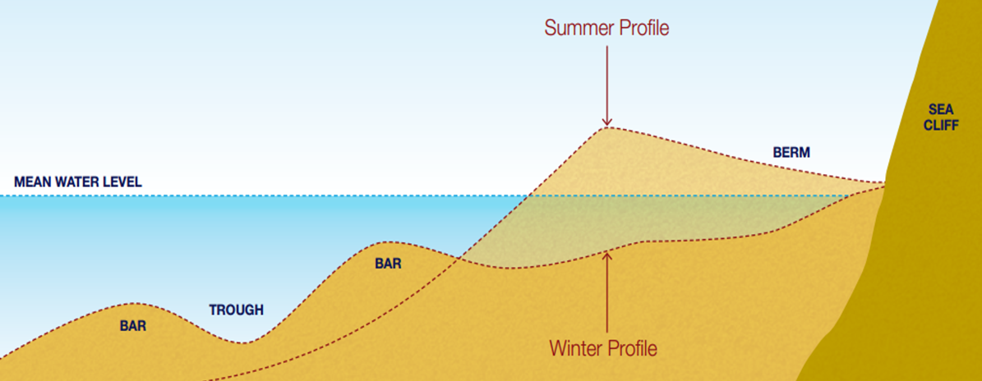
Winter Vs Summer Profile
Notes:
Discuss about waves and their impact on beach profiles.
This will have an impact on your response particularly if the spill occurs during the period in which the beach is being built back up (Summer) – this will result on burial
Beaches erode in winter and are built up in the summer, correlates to the type of wave present i.e. Plunging breaker (eroder) more common in winter storms
Oil stranded in the summer moving into winter the beach starts to become eroded therefore the oil moves with the sediment and gets broken down as the sediment is moved.
Oil stranded in the winter moving into summer the beach begins to get built up and potentially buried.
Example, Deepwater spill happened in April 2010. During the next few months as the response was ongoing, the beach profile was built up (summer profile) and the oil was buried.
Knowing what season you are in and how that affects the beach profile. If you know the beach is going to begin to be built up then you know you could potentially have buried oil.

Slide 13
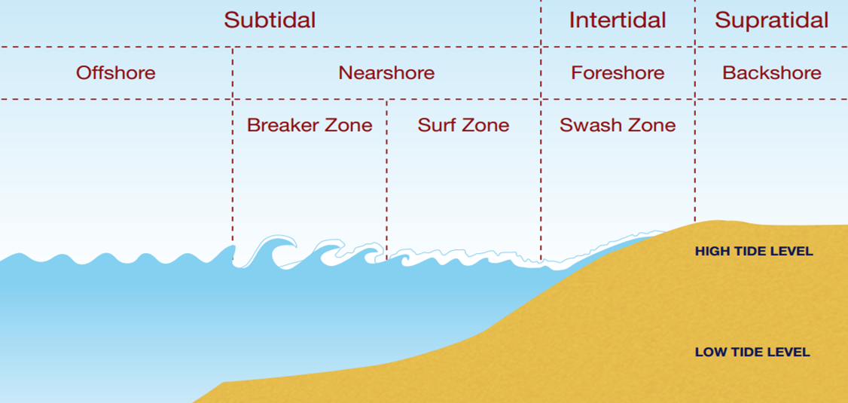
Notes:
MHWS = Mean high water Springs
MHWN = Mean high water Neaps

Slide 14
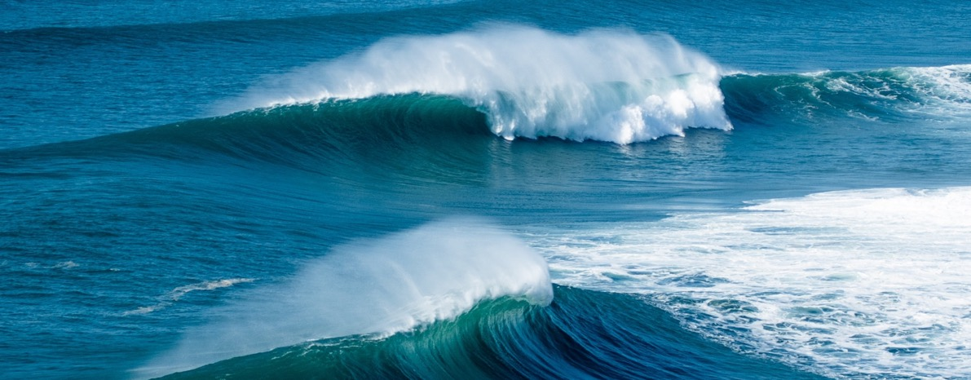
Tides
Notes:
Section divider, moving from wave energy into tidal influence. Signpost that the next few slides cover tidal zonation and tidal range terminology (springs/neaps), which underpin shoreline survey timing and SCAT planning.

Slide 15
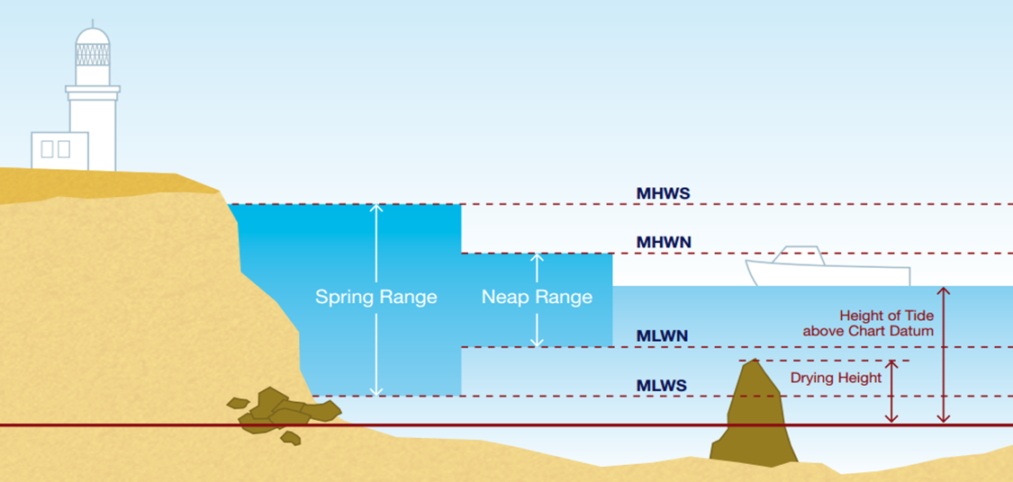
Notes:
MHWS = Mean high water Springs
MHWN = Mean high water Neaps

Slide 16
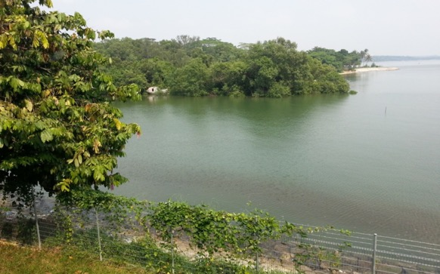
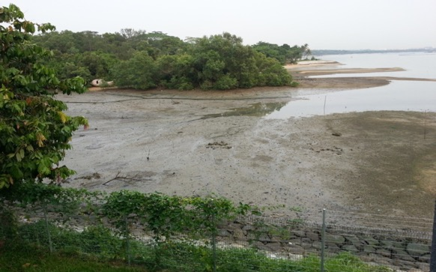
When is the best time to survey a shoreline?
Notes:
Get delegates to answer high tide or low tide

Slide 17
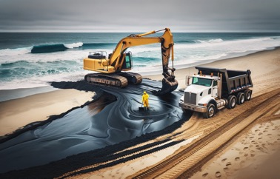
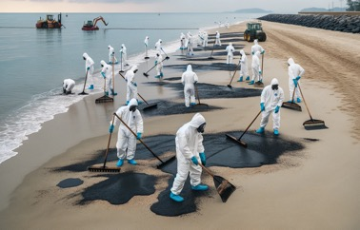

Three Stages of Clean-up
Stage 1
Stage 2
Stage 3
Removal of heavy contamination and floating oil.
Clean-up of moderate contamination, stranded oil and oiled beach materials.
Final clean-up of light contamination and oily stains.
Notes:
Introduce the three-stage clean-up model:
Stage 1 - removal of heavy contamination and floating oil.
Stage 2 - clean-up of moderate contamination, stranded oil and oiled beach materials.
Stage 3 - final clean-up of light contamination and oily staining.
Emphasise that this phased approach avoids over-cleaning and allows shorelines to be progressively surveyed and signed off.

Slide 18

What Shoreline Treatments do you know?
Research in pairs and write all ideas on board
Notes:
Facilitator exercise: delegates work in pairs to research and write down as many shoreline treatment techniques as they can think of on the board. Use their answers to lead into the formal list of ten techniques on the next slide.

Slide 19
Shoreline Clean-up Techniques
01
Debris Removal
07
Manual Clean-up
02
Natural Recovery
08
Surf Washing
03
Mechanical Recovery
08
Sorbent Use
04
Water Flushing
09
Tiling/Harrowing/Ploughing
05
High Pressure Washing
10
Bioremediation
Notes:
Overview slide listing the ten shoreline clean-up techniques covered in this module: Debris Removal, Natural Recovery, Mechanical Recovery, Water Flushing, High Pressure Washing, Manual Clean-up, Surf Washing, Sorbent Use, Tilling/Harrowing/Ploughing, and Bioremediation. Each is covered in more detail over the following slides, generally two techniques per slide.

Slide 20

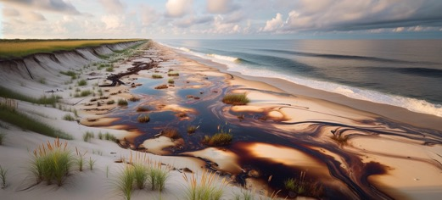
Debris Removal
Natural Recovery
Techniques: Combining manual and mechanical methods for removing flotsam, jetsam, and organic matter.
Reducing Hazardous Waste: Lessens the amount of contaminated waste needing hazardous treatment.
Ecosystem Impact: Influences local ecosystems by removing organic matter.
Aerial Support: Utilizing aerial reconnaissance for efficient removal.
Natural Removal Process: Oil is naturally removed through sea water and microorganism interaction.
Weathering Mechanisms: Processes include abrasion, clay-oil flocculation, and more.
Timeframe Variation: One seasonal cycle for high energy shorelines, two to three years for low energy.
Perception: May seem inactive but is a natural, ongoing process
Notes:
Debris Removal: combines manual and mechanical methods to remove flotsam, jetsam and organic matter; reduces the volume of contaminated waste requiring hazardous treatment; aerial reconnaissance can support efficient planning.
Natural Recovery: relies on wave and microorganism action (abrasion, clay-oil flocculation and other weathering) to break down oil naturally. Timeframe varies from one seasonal cycle on high-energy shorelines to two-to-three years on low-energy shorelines. Stress to delegates that choosing natural recovery is a deliberate, monitored response decision, not inaction.

Slide 21
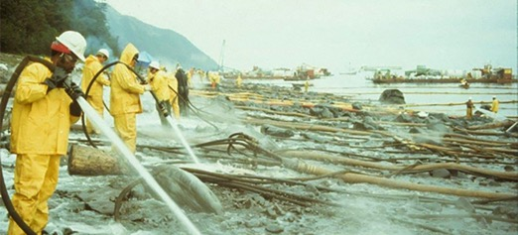
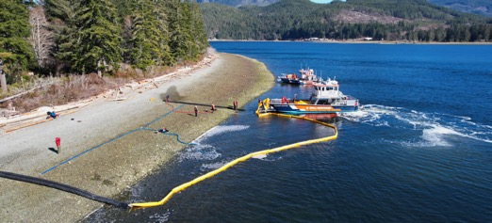
High Pressure Washing
Water Flushing
Equipment: Uses heavy machinery like graders, loaders, and tractors.
Pumping for Pollutants: Pumping equipment for contained pollutants, with storage transfer.
Recovery Variability: Strategy depends on oil's characteristics.
Advantages: Effective in high water and debris scenarios.
Flushing involves high volumes of water at low pressure to wash stranded, or buried, oil from shorelines.
The two most common applications of this technique are the removal of buried oil or removal of surface oil from sensitive areas like tidal mud flats and salt marshes.
This technique is often used in conjunction with sorbent deployment to collect oil released during the flushing process.
Operation is limited by the tidal cycle.
Notes:
Trainer note: the four intro bullets under 'High Pressure Washing' (Equipment/Pumping/Recovery Variability/Advantages) appear to be duplicated from the Mechanical Removal slide - worth checking against the source material before delivery, as they describe heavy plant rather than washing.
Water Flushing: uses high volumes of low-pressure water to wash stranded or buried oil from shorelines, commonly used to remove buried oil or to clear surface oil from sensitive areas like tidal mud flats and salt marshes. Often used alongside sorbents to collect the released oil. Operation is limited by the tidal cycle.
High Pressure Washing: a more aggressive technique for stubborn or weathered oil on hard substrates - flag the higher risk of ecological damage, so use selectively.

Slide 22
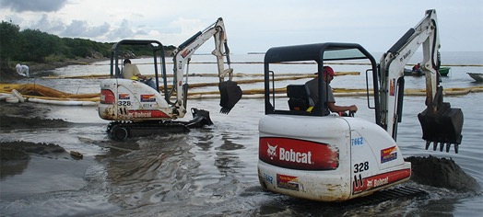
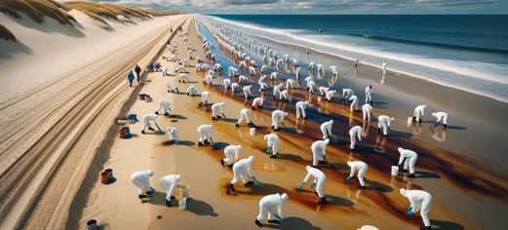
Mechanical Removal
Manual Clean-up
Equipment: Uses heavy machinery like graders, loaders, and tractors.
Pumping for Pollutants: Pumping equipment for contained pollutants, with storage transfer.
Recovery Variability: Strategy depends on oil's characteristics.
Advantages: Effective in high water and debris scenarios.
Utilised on non-fluid stranded oil and oiled beach materials (sand and shingle) on shorelines accessible on foot.
Oil can be removed with a variety of implements being, trowels, scrapers, rakes and shovels. Recovered oil is usually placed in heavy-duty plastic bags.
Labour and time intensive with a high degree of coordination required.
Notes:
Mechanical Removal: uses heavy machinery (graders, loaders, tractors) and pumping equipment for contained pollutants; effective for high water and debris scenarios but strategy depends on the oil's characteristics.
Manual Clean-up: used on non-fluid stranded oil and oiled beach materials (sand and shingle) on shorelines accessible on foot, using trowels, scrapers, rakes and shovels; recovered oil is bagged in heavy-duty plastic. Labour- and time-intensive with a high degree of coordination required, but allows very selective removal.

Slide 23
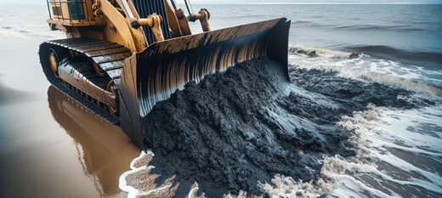
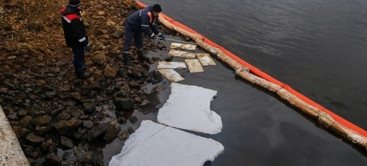
Surf Washing
Sorbent Use
Natural process, which can be enhanced by using labour or heavy plant to relocate contaminated substrate into the surf zone.
Utilises the wave energy in the intertidal surf zone to remove oil from the substrate through abrasion, oil-mineral aggregates (molecules of oil absorbed on to mineral surfaces), and dispersion (and potentially evaporation).
Alters the beach profile and restricted by the tidal cycle.
Sorbents can be used to collect product from the shore, manmade structures or floating on the marine environment.
They are bagged and stored at the temporary waste storage area for contaminated solids.
The large-scale use of sorbents is not advocated as it increases the quantities of waste produced.
Notes:
Surf Washing: a natural process that can be enhanced by labour or heavy plant relocating contaminated substrate into the surf zone, where wave energy removes oil through abrasion, oil-mineral aggregation and dispersion. Alters the beach profile and is restricted by the tidal cycle.
Sorbent Use: sorbents collect oil from the shore, structures or the water surface, and are bagged and stored at the temporary waste storage area. Caution delegates that large-scale sorbent use is not advocated, since it increases the quantity of waste produced.

Slide 24
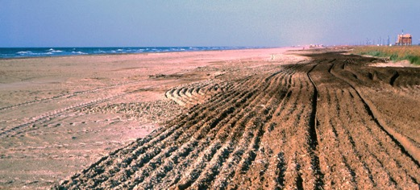
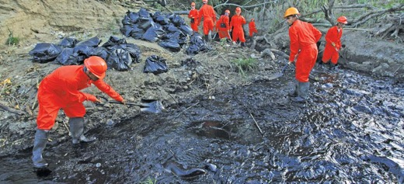
Tilling, Harrowing and Ploughing
Bioremediation
Use of agricultural equipment to plough, or harrow, lightly contaminated sediment. The ploughing action breaks up the sediments, increasing the surface area of oil exposed to weathering processes, facilitates clay-oil flocculation or mineral-oil aggregation.
The process also assists in aerating the sediment, allowing for naturally occurring littoral micro-organisms to readily degrade the oil.
Can impact the littoral ecosystem.
Bio-remediation Technique: Uses microorganisms to decompose pollutants.
Natural Attenuation: Relies on existing microbial populations and environmental factors.
Bio-augmentation: Adds specific microbes to enhance pollutant degradation.
Efficacy Factors: Influenced by pollutant type, environmental conditions, and microbial activity.
Notes:
Tilling/Harrowing/Ploughing: uses agricultural equipment to turn over lightly contaminated sediment, increasing the surface area of oil exposed to weathering and assisting clay-oil flocculation or mineral-oil aggregation; also aerates the sediment to support naturally occurring micro-organisms. Flag the potential impact on the littoral ecosystem.
Bioremediation: uses micro-organisms to decompose oil, either through natural attenuation (existing microbial populations) or bio-augmentation (adding specific microbes). Effectiveness depends on pollutant type, environmental conditions and microbial activity.

Slide 25
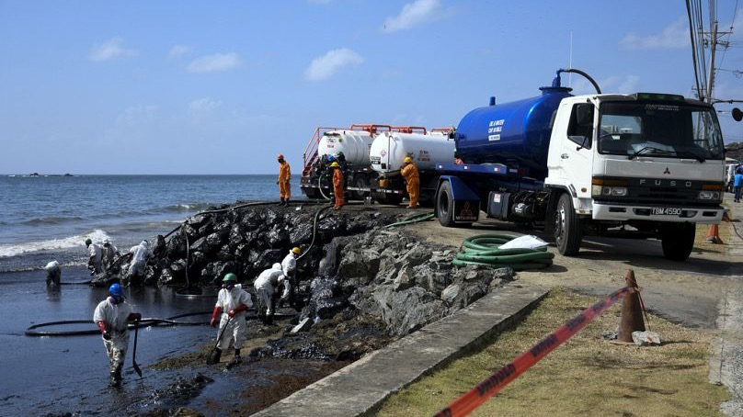
Site Set Up
Notes:
Section divider. Moves from treatment techniques into the practicalities of setting up a shoreline response site - zoning, logistics, staging and decontamination.

Slide 26
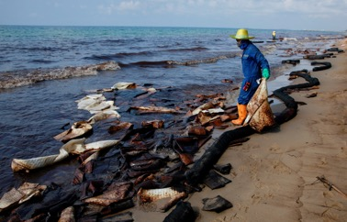
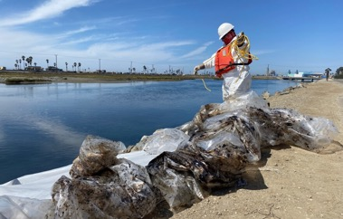
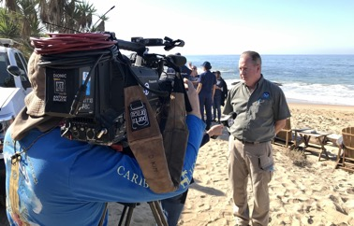
Shoreline Site Set Up - Zones
Hot Zone
Warm Zone
Cold zone
Area of direct contamination and oil removal.
Highest risk from exposure to hazardous substances.
Restricted to trained personnel with protective gear.
  Buffer zone for decontaminating personnel and equipment.
  Moderate risk with potential indirect contaminant contact.
  Limited to personnel needing passage or involved in decontamination.
Clean area housing support services and command centers.
Minimal or no exposure risk.
Open to all personnel for staging and administrative functions.
Notes:
Walk through the three-zone system used on a shoreline response site:
Hot Zone - area of direct contamination and oil removal; highest risk; restricted to trained personnel in protective gear.
Warm Zone - buffer zone for decontaminating personnel and equipment; moderate/indirect contact risk; limited to personnel needing passage or involved in decontamination.
Cold Zone - clean area housing support services and command centres; minimal/no exposure risk; open to all personnel for staging and admin.
Use the photos to anchor each zone to a real example.

Slide 27
Shoreline Treatment Recommendation Form
Notes:
Walk delegates through the Shoreline Treatment Recommendation form, explaining each field and how survey findings feed into the recommended treatment. Consider having delegates complete a sample form later using a scenario shoreline.

Slide 28
Segment Inspection Form
Notes:
Introduce the Segment Inspection form used to record shoreline survey/SCAT data by segment (oiling extent, substrate, sensitivity, access, recommended treatment). Explain how this feeds into the Treatment Recommendation form on the previous slide.

Slide 29
Shoreline Booming
Notes:
Section divider introducing shoreline booming - containment, deflection and protection booms used to protect sensitive shorelines and support recovery operations.

Slide 30
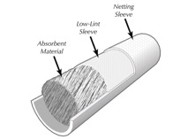
Booms
Solid Floatation Fence Boom
Absorbent Boom
Tension Member
Freeboard
Flotation
Water line
skirt
Draft
Ballast
Air Inflation Curtain Boom
Shore Sealing Boom
Freeboard
Air
Tension Member
Flotation
Air
Draft
skirt
Water
Water
Ballast
Notes:
Introduce the four main boom types and their construction:
Solid Flotation Fence Boom - rigid floats, skirt and ballast; a versatile all-rounder.
Absorbent Boom - sorbent material, best suited to thin sheens and final polishing rather than heavy containment.
Air Inflation Curtain Boom - inflatable flotation chamber; packs down small, good for rapid deployment.
Shore Sealing Boom - designed to seal against the shoreline to stop oil getting behind it.
Use the labelled cross-sections to explain common boom anatomy: freeboard, draft, flotation, skirt, ballast and tension member.

Slide 31
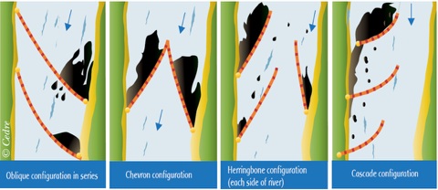
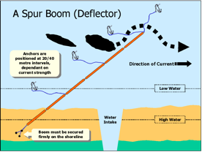
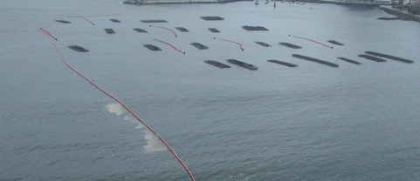
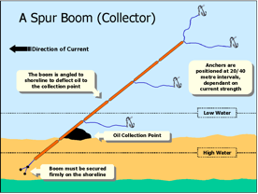
Nearshore Protection / Deflection
Notes:
Cover deflection boom configurations used to protect sensitive nearshore areas or water intakes: oblique (in series), chevron, herringbone (used on each side of a river mouth) and cascade configurations.
Then introduce the Spur Boom in its two roles - Deflector (redirects oil away from a sensitive point, e.g. a water intake) and Collector (angles oil toward a collection point). Note anchor spacing (20-40 m depending on current strength) and that the boom must always be secured firmly to the shoreline.

Slide 32
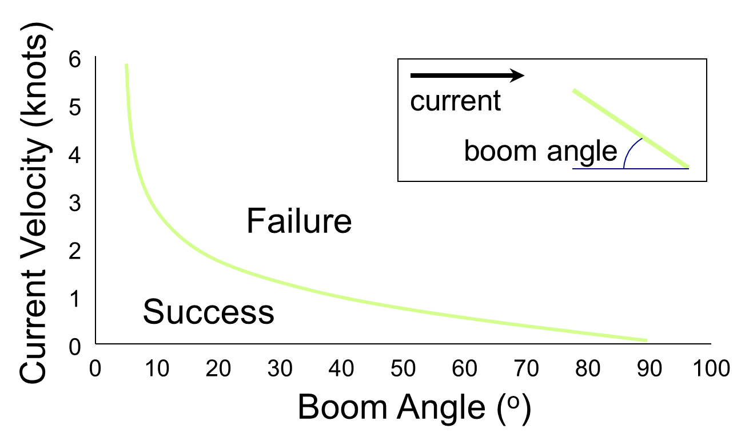
Points of Failure
Notes:
Explain the critical relationship between current velocity and boom angle: as current increases, the boom must be deployed at a shallower angle relative to the current to avoid failure (oil escaping under or past the boom). The 'Success' zone sits at low current/wide angle; the risk of 'Failure' rises sharply as current increases. This is the technical basis for the deployment-angle examples on the next slide.

Slide 33
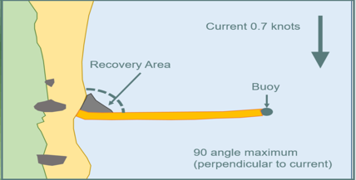
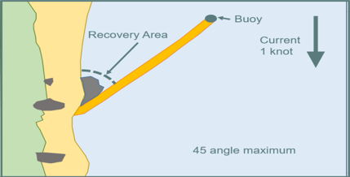
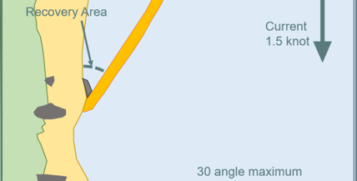
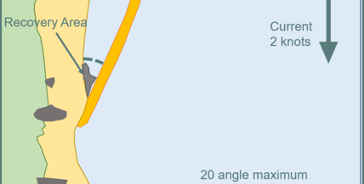
Boom Angle of Deployment
Notes:
Apply the previous slide's principle with worked examples: at 0.7 knots current a boom can be deployed at 90 degrees (perpendicular) to the current; as current rises to 1, 1.5 and 2 knots the maximum safe angle narrows to 45, 30 and 20 degrees respectively.
0.7 knots is commonly cited as the critical current velocity above which conventional boom containment starts to fail, so the deployment angle must be reduced to keep the effective current across the boom below this threshold.

Slide 34
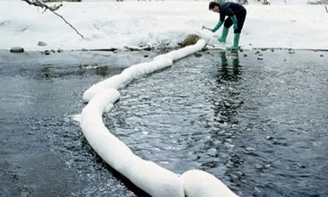
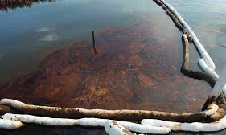
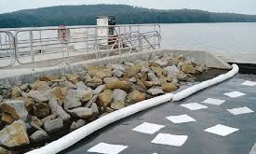
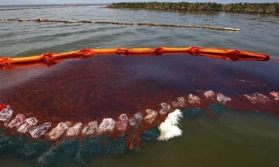
Absorbent Boom
Notes:
Show examples of absorbent (sorbent) boom construction and deployment. Reinforce from the earlier technique slides that absorbent boom suits thin sheens and final polishing rather than heavy oil containment, and generates waste that must be tracked and disposed of.

Slide 35
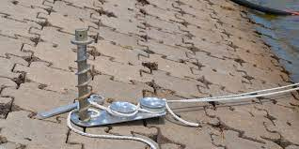
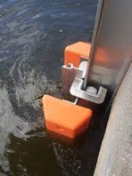
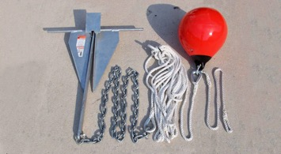
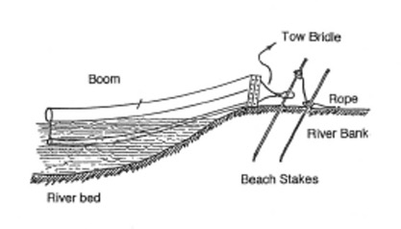

Boom Ancillaries (Fixings)
Notes:
Run through the anchoring and fixing hardware used to secure booms - anchors, connectors and beach staking systems. Emphasise that a boom is only as effective as its anchoring; inadequate fixing is a common real-world point of failure.

Slide 36


Boom Anchoring
Notes:
Cover near-shore anchoring techniques and layouts, building on the fixings covered on the previous slide. Discuss how anchor spacing and type need to suit the seabed/shoreline conditions and the expected current and wave loads.

Slide 37

Boom Connections – Tidal Compensator
Notes:
Explain the running mooring / tidal compensator connection, which allows a boom to ride up and down with the tide while remaining anchored, keeping it correctly positioned across the full tidal cycle.

Slide 38

https://vimeo.com/97120695?fl=pl&fe=cm
Notes:
Play the linked video showing shoreline booming deployment in practice - confirm the link and audio/video work before the session. Use it to consolidate the deployment principles covered on the previous slides.

Slide 39
Your Shorelines
What shoreline treatment would you use for their local shoreline?
Notes:
Closing discussion: ask delegates to apply what they have learned to a shoreline they know locally - which treatment(s) would they use, and why. Use this to check understanding and wrap up the module.

